Slide 1

Welcome
Back to School
2024-2025
Fourth Grade Open House
Dr. Dianesha R-Freeman
Notes:
NOTE: Want a different image on this slide? Select the picture and delete it. Now click the Pictures icon in the placeholder to insert your own image.

Slide 2
Barton Chapel Elementary School
Principal: Dr. Christi Wise
Assistant Principal: Dr. Stewart
School Number: (706)796-4955
School Hours : 7:50 am – 3:05 pm

Slide 3



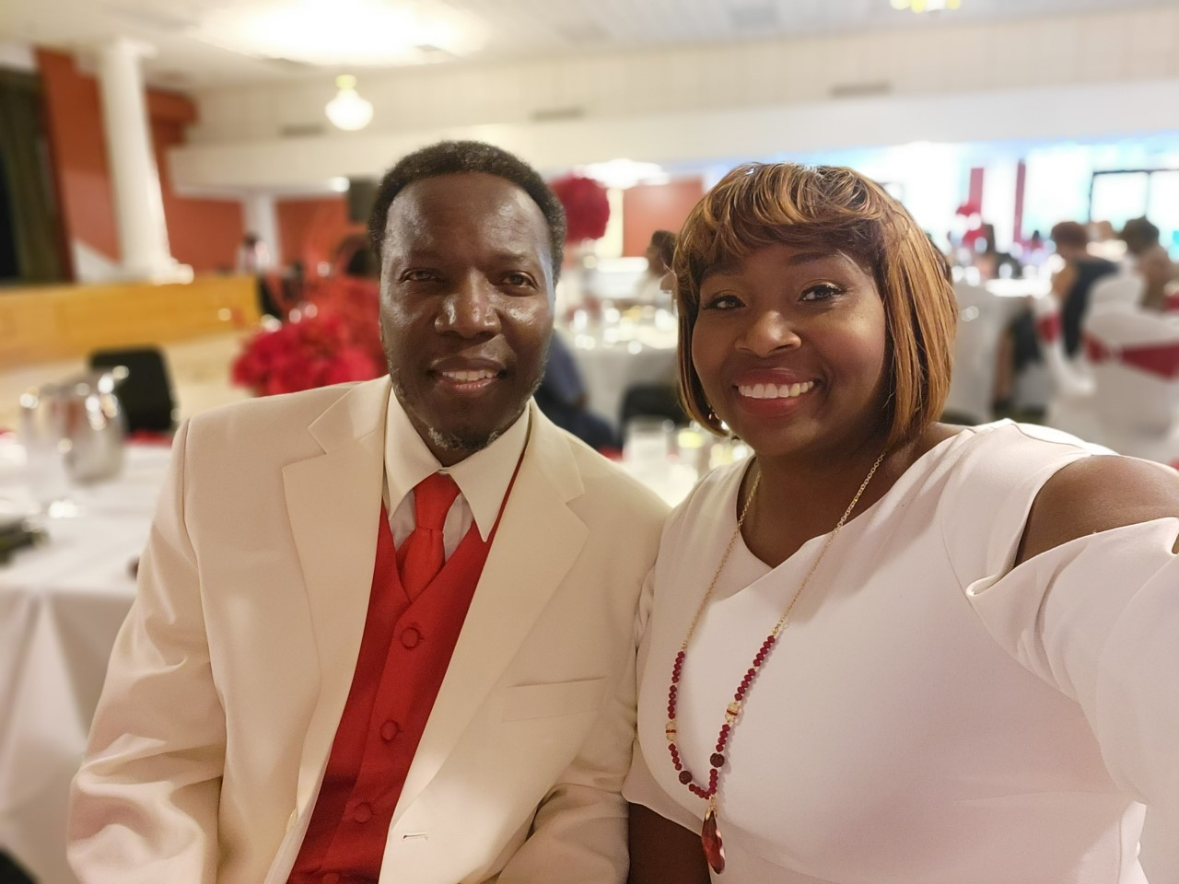
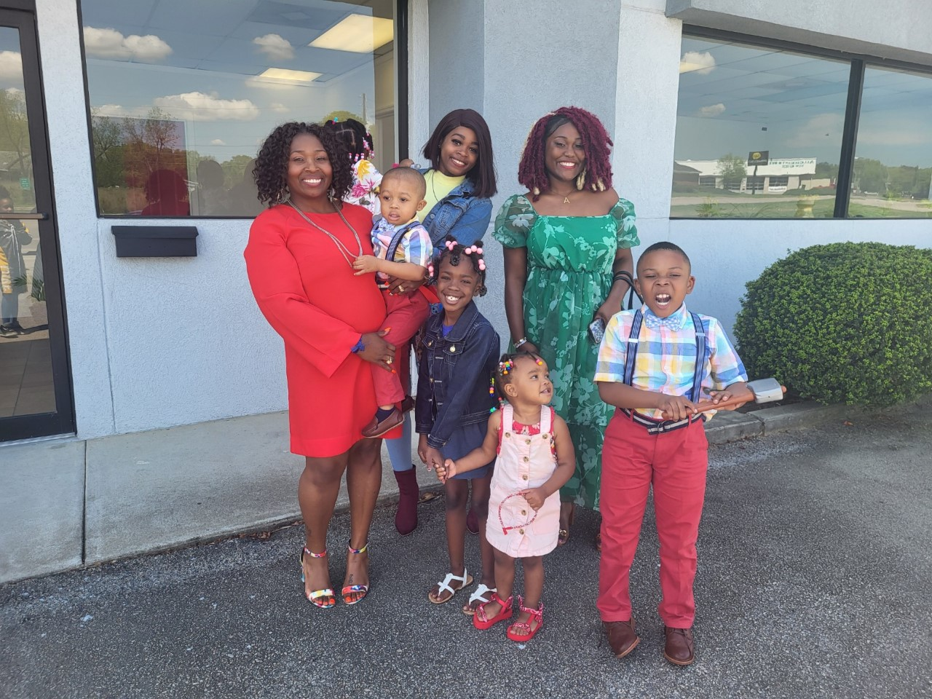
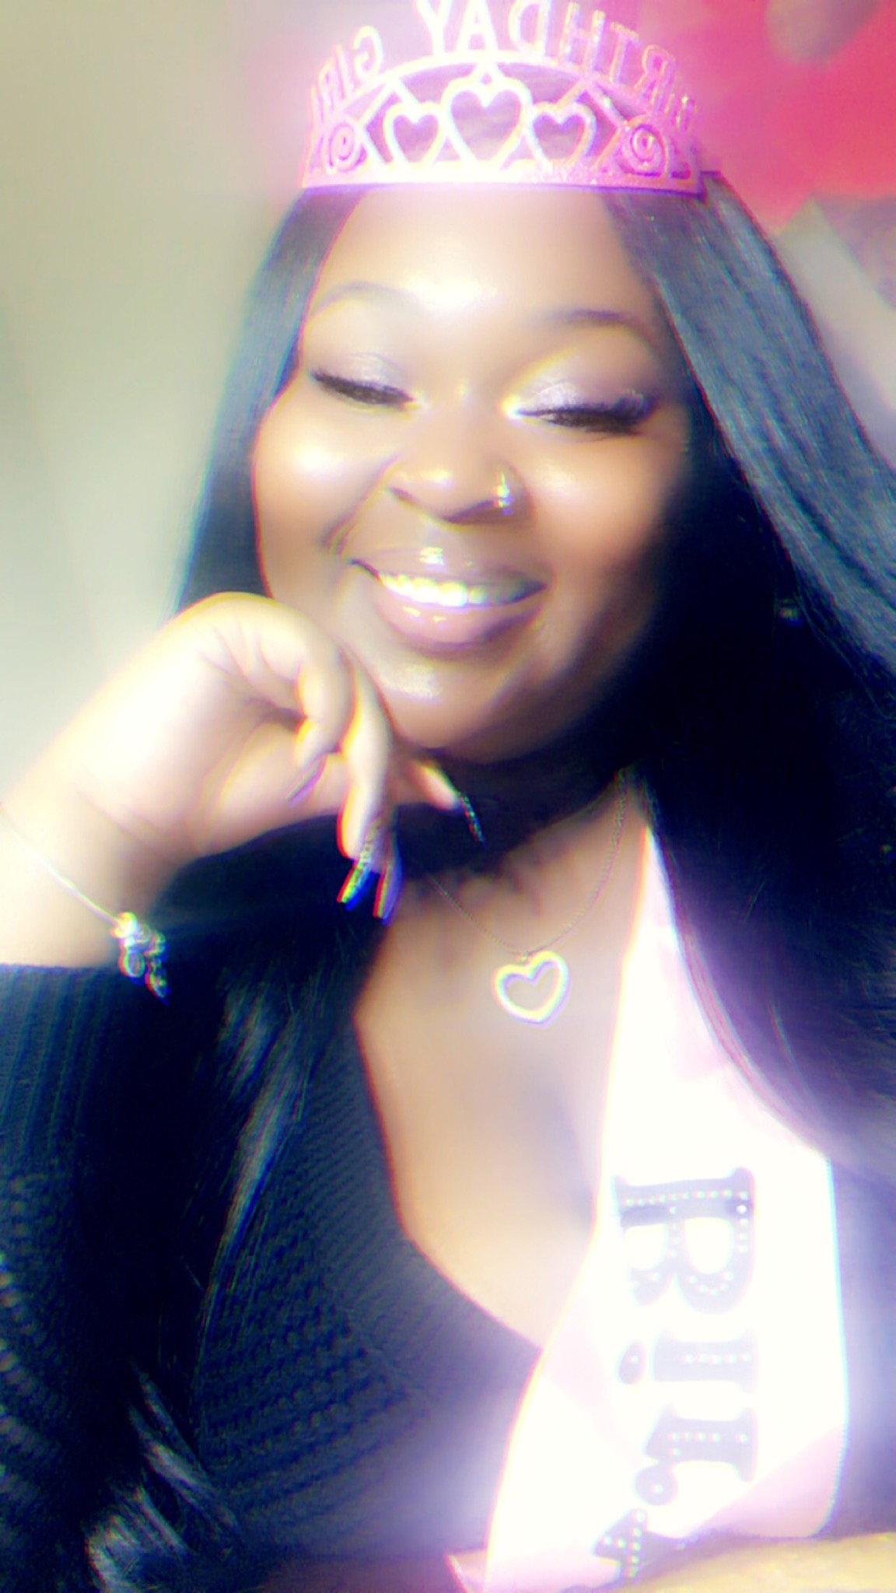
Dr. Freeman
I’ve been at BCE for 9 years. In education 22 years. I believe every child can learn if they are in a positive environment surrounded by people that believe in them.
I’m married to Mr. Kenneth Freeman and we have 4 children (De’ja, Alexis, Amber, and Kingston). I also have 2 grandchildren (Majesty and Major).
I graduated from Augusta State University, Brenau University, and East Georgia College.
I enjoy singing, playing piano, watching movies, spending time with family, and traveling.

Slide 4
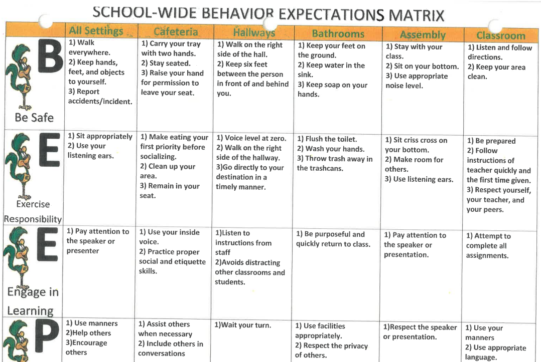
Teacher Contact Information
Dr. Dianesha Robinson-Freeman
(706) 414-5980
robindi@Richmond.k12.ga.us
Room 150
Planning Time: 2:00 – 2:45pm

Slide 5
Instructional Time for the 2023-2024 School Year
Interventions - 50
Science – 45 minutes
Social Studies – 45 minutes
Specials – Art, Music, P.E.,

Slide 6

Student Behavior
Expectations

Slide 7


Student
Conduct Information
1st line of communication – Homework, Conduct/Behavior, Messages
This Photo by Unknown Author is licensed under CC BY-SA-NC

Slide 8

What is Canvas? And, how will it be used in 2nd grade?
Classwork
Assessments
Learn at Home Days

Slide 9
Supply Lists:
3 Spiral Notebooks –Science, Social Studies, Morning Work/Writing
2 Pencils - #2 (No Mechanical)
Glue Sticks
Color Pencils
Scissors
Personal Sanitizer
Hand held pencil sharpener with catcher

Slide 10

Questions????
Please sign the sign-in sheet before you leave
Thanks for attending Open House.
Let’s Have a Wonderful 2024-2025 School Year!!!

